Slide 1
Schengen rules concerning professional drivers
24. April 2025. Room AB.1B, Centre de Conférences Albert Borschette
Rue Froissart 36, Brussels

Slide 2
Attendants
National authorities
Other participants from non Schengen countries
Associations of road hauliers
Chambers of Commerce

Slide 3
Legislation
Convention implementing the Schengen agreement of 14 june 1985
Regulation (EU) 2016/399
Regulation (EU) 2017/2226
Visa liberalisations Agreements
"no more than 90 days in any 180-day period, which entails considering the 180-day period preceding each day of stay, the entry conditions for third-country nationals”

Slide 4
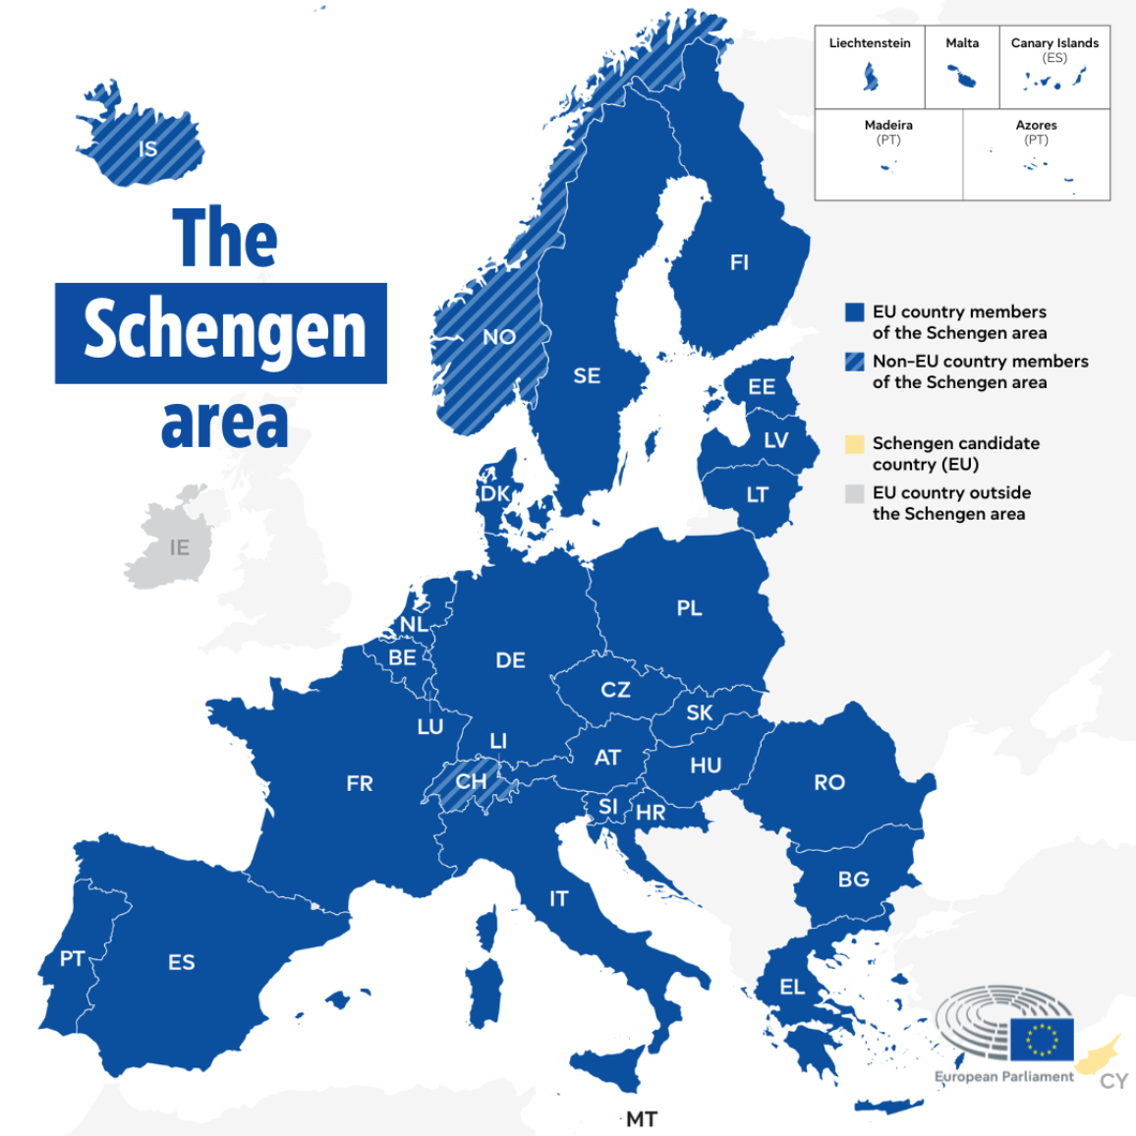
”

Slide 5
”

Slide 6
In practice
Serbian truck is apx for 2h (Croatia, Hungary, Romania, Bulgaria) in Schengen area
Trip duration for this truck on relation Belgrade (SRB) – Dusseldorf (D) - Belgrade (SRB) is 7 days
Trip duration for this truck on relation Belgrade (SRB) – Lisabon(P) - Belgrade (SRB) is 14 days
~ 0,5-1,5% of transport duration is in non Schengen area or 98,5-99 ,5% time in Schengen area

Slide 7
In practice
loading/custom
driving
driving
driving
loading/custom
driving
driving
pause or rest
cross border non Schengen / Schengen
driving
pause or rest
custom/unload
cross border non Schengen / Schengen
pause or rest
pause or rest
custom/unload

Slide 8
In practice
loading/custom
driving
driving
pause or rest
cross border non Schengen / Schengen
driving
pause or rest
custom/unload
driving
driving
driving
loading/custom
custom/unload
pause or rest
pause or rest
cross border non Schengen / Schengen

Slide 9
"no more than 90 days in any 180-day period, which entails considering the 180-day period preceding each day of stay, the entry conditions for third-country nationals”
Stay in the Schengen zone = living on the territory of Schengen + working on the territory or Schengen + employee of company on that territory (or irregular work) + no border crossings/no returning to motherland for some period
Driving a truck in international transport via Schengen zone= living in truck & driving on the territory or Schengen goods vehicle registered in the non-Schengen country + employee of the company from non-Schengen country + frequently&regular crossings of border in truck returning to motherland via truck line
stay ≠ driving a truck in international transport

Slide 10
stamps in passport
EES
ETIAS
Control of 180 days period for proffesional drivers

Slide 11
Schengen & non–Schengen citizens
Schengen & non–Schengen industry
non-Schengen hauliers
non-Schengen driver
Influence of limmited “stay” for professional drivers

Slide 12
Schengen & non–Schengen citizens
Schengen & non–Schengen industry
non-Schengen hauliers
non-Schengen driver
Influence of limmited “stay” for professional drivers
without normal work conditions (lower sallary, psychological impact)
without normal life (no vacation, no visit to family, no enough money for living)

Slide 13
Schengen & non–Schengen citizens
Schengen & non–Schengen industry
non-Schengen hauliers
non-Schengen driver
Influence of limmited “stay” for professional drivers
transport price increase
new drivers out of Europe
driver with less experience
shutdown business (no drivers no business)

Slide 14
Schengen & non–Schengen citizens
Schengen & non–Schengen industry
non-Schengen hauliers
non-Schengen driver
Influence of limmited “stay” for professional drivers
increased transport prices
lack of transport capacity
delay in producton
delay in deliveries to customers

Slide 15
Schengen & non–Schengen citizens
Schengen & non–Schengen industry
non-Schengen hauliers
non-Schengen driver
increased prices of products
lack of products
new drivers with less experience in everyday traffic and higher risk of accidents and mistakes
Influence of limmited stay for proffesional drivers

Slide 16
Schengen & non–Schengen citizens
Schengen & non–Schengen industry
non-Schengen hauliers
non-Schengen driver
increased prices of products
lack of products
new drivers with less experience in everyday traffic and higher risk of accidents and mistakes
Influence of limmited stay for proffesional drivers
increased prices of products
lack of products
new drivers with less experience in everyday traffic and higher risk of accidents and mistakes
This violates the basic human rights and principles given by the European Convention on Human Rights:
the right to respect for private and family life (Article 8),
the prohibition of discrimination (Article 14),
jeopardize the freedom of movement (Article 2 of Protocol IV),
general prohibition of discrimination (Article 1 of Protocol XII).
increased prices
lack of transport capacity
delay in producton
delay in deliveries to customers
without normal work conditions (lower sallary, psychological impact)
without normal life (no vacation, no visit to family, no enough money for living)

Slide 17
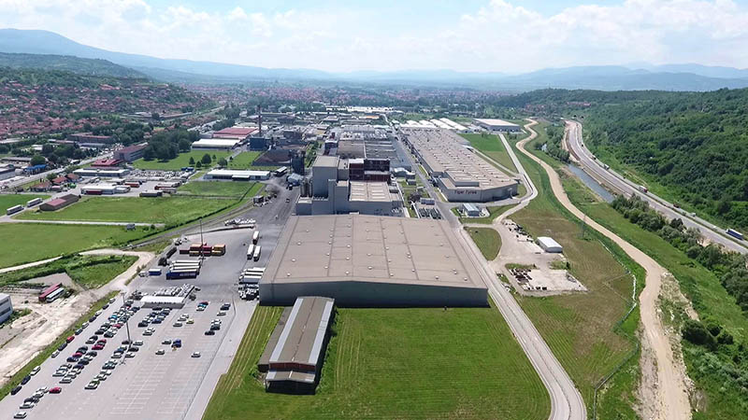
NESTLE ADRIATIC S
KRKA-FARMA
GREINER PACKAGING
MIELE
S.OLIVER
GORENJE
PHOENIX PHARMA
SIEMENS
CISCO SRBIJA
KLACSKA JUGOSLAVIJA
EINHELL
ZF SERBIA
ORIFLAME
DELHAIZE
TIGAR TYRES
ROBERT BOSCH
DR. OETKER
BASF SRBIJA
CHIPS WAY
DHL INTERNATIONAL
MERCEDES BENZ
CITROEN
PEUGEOT FIAT SCANIA DAF MICHELIN AIRBUS RAUCH HENKEL
VOLKSWAGEN
RENAULT
LEONI
MAGMA IVECO
ŠKODA
OPEL
...
ROBERT BOSCH
BASF
BAYER
BOYSEN ABGASSYSTEME
BROSE
DAD DRÄXLMAIER AUTOMOTIVE
CONTINENTAL AUTOMOTIVE
GRUNER
HENKEL
LIDL
LEONI WIRING
MEGGLE
NORMA GRUPA
SIEMENS
VORWERK AUTOTEC
XELLA
...
HENKEL
OMV
METRO CASH & CARRY
DM DROGERIE MARKT
GRUNDFOS SRBIJA
SIEMENS MOBILITY
IKEA
BARRY CALLEBAUT SOUTH EAST
VEROPOULOS
RAUCH
PORSCHE
BAYER
GEODIS SCO
KNAUF INSULATION
FLENDER
LIDL
… and 7857 more just in Serbia

Slide 18
NESTLE ADRIATIC S
KRKA-FARMA
GREINER PACKAGING
MIELE
S.OLIVER
GORENJE
PHOENIX PHARMA
SIEMENS
CISCO SRBIJA
KLACSKA JUGOSLAVIJA
EINHELL
ZF SERBIA
ORIFLAME
DELHAIZE
TIGAR TYRES
ROBERT BOSCH
DR. OETKER
BASF SRBIJA
CHIPS WAY
DHL INTERNATIONAL
MERCEDES BENZ
CITROEN
PEUGEOT FIAT SCANIA DAF MICHELIN AIRBUS RAUCH HENKEL
VOLKSWAGEN
RENAULT
LEONI
MAGMA IVECO
ŠKODA
OPEL
...
ROBERT BOSCH
BASF
BAYER
BOYSEN ABGASSYSTEME
BROSE
DAD DRÄXLMAIER AUTOMOTIVE
CONTINENTAL AUTOMOTIVE
GRUNER
HENKEL
LIDL
LEONI WIRING
MEGGLE
NORMA GRUPA
SIEMENS
VORWERK AUTOTEC
XELLA
...
HENKEL
OMV
METRO CASH & CARRY
DM DROGERIE MARKT
GRUNDFOS SRBIJA
SIEMENS MOBILITY
IKEA
BARRY CALLEBAUT SOUTH EAST
VEROPOULOS
RAUCH
PORSCHE
BAYER
GEODIS SCO
KNAUF INSULATION
FLENDER
LIDL
DEPENDENCY
…

Slide 19
Why now?

Slide 20
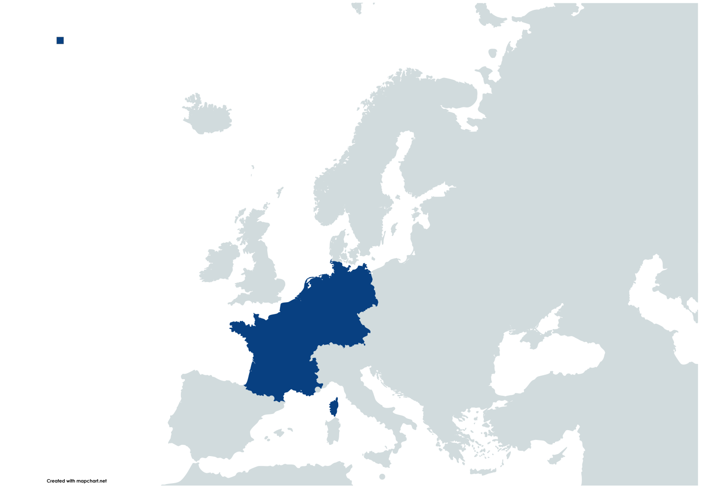
Why now?
”
1995

Slide 21
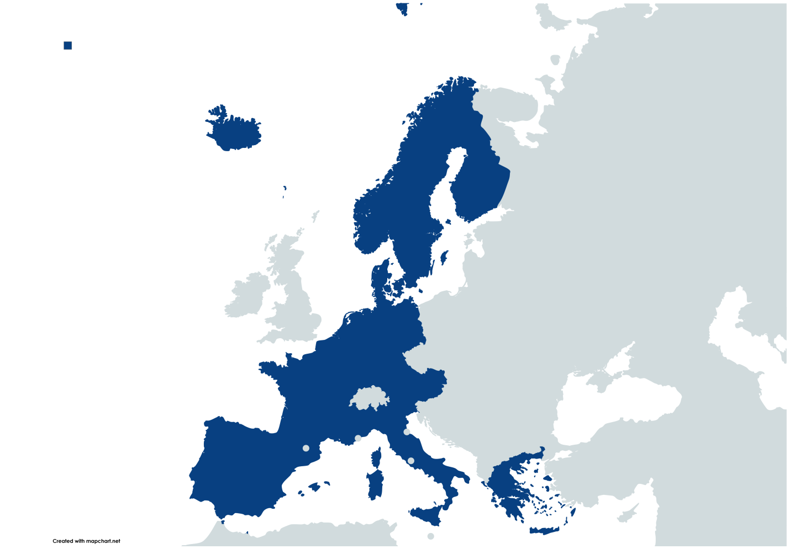
Why now?
”
1995
2006

Slide 22
Why now?
2025
”

Slide 23
Why now?
2025
more countries within the Schengen area
more vehicles and less drivers
long stays at the external borders of the EU on the entrance and exit
constant demand for the fastest possible turnover of vehicles, especially in the auto industry
”

Slide 24
EC
“extended legal stay”
H
Annex 7
cross border workers
how to apply?
how to fulfill cause it is not one border crossing?
what about internal checks?
CRO
BG
RO
GR
NOT POSSIBLE
NO ANSWER
NO ANSWER
NO ANSWER
NO ANSWER
potential amendments
Solutions

Slide 25
Transport industry
Amendment for exemption of truck drivers like a crew member (driver within truck exempted from limited stay in scope of transit journey: non Schengen-Schengen-non Schengen area)
Annex 7 cross border workers without EES
With procedures and acceptance of all countries
Drivers documents via web aplication: passport, driving license, qualification card (code95), document from company about working period, document from state authority (Ministery of Transport for ex) could be enough to recognize professional driver operation and need to pass with a truck across Schengen through truck line on CB
Extended stay in neighboring countries is not full solution cause it is only valid for that country and rest will calculate 90 days in 180 days
Calculation method (hours instead days)
Period of “stay” less than 10 days does not calculate in period of 90 days in 180 days
Solutions

Slide 26
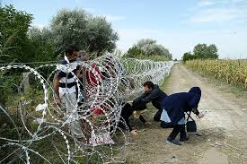
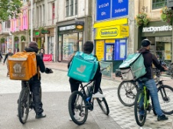
Reasons
combat illegal immigration and trafficking in human beings?
to prevent any threat to the Member States’ internal security?
illegally work?

Slide 27
VS

Slide 28
DIFFERENCES BETWEEN TRUCK DRIVERS AND OTHER GROUPS OF PEOPLE IN SCHENGEN
legal entrance | x | √ | √
self-initiated exit soon after entrance | x | x | √
legal documents | x | √ | √
legal job, income via banc account, health insurance (obligatory and volontary travel health policy) | x | x | √
frequently entry&exit | x | x | √
entrance&exit via truck line/gate | x | x | √
professional documents: driving licence, code95, ADR, tacho card, registration in ministry... | x | x | √
possibility for legal work&live in Schengen | x | x | √
attractive income in motherland | x | x | √
living on the territory of Schengen | √ | √ | x
intention to stay on the territory of Schengen | √ | √ | x

Slide 29
combat illegal immigration and trafficking in human beings?
to prevent any threat to the Member States’ internal security?
illegally work?

Slide 30
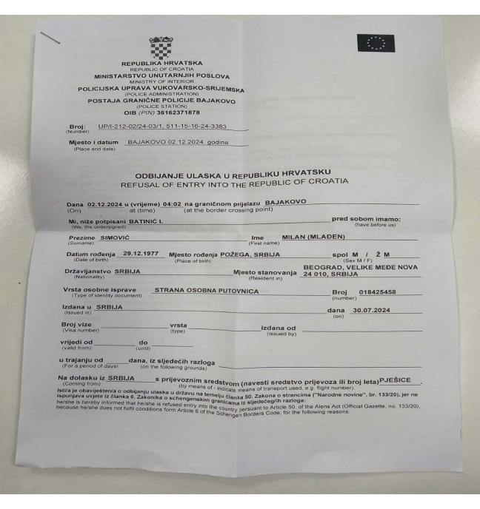
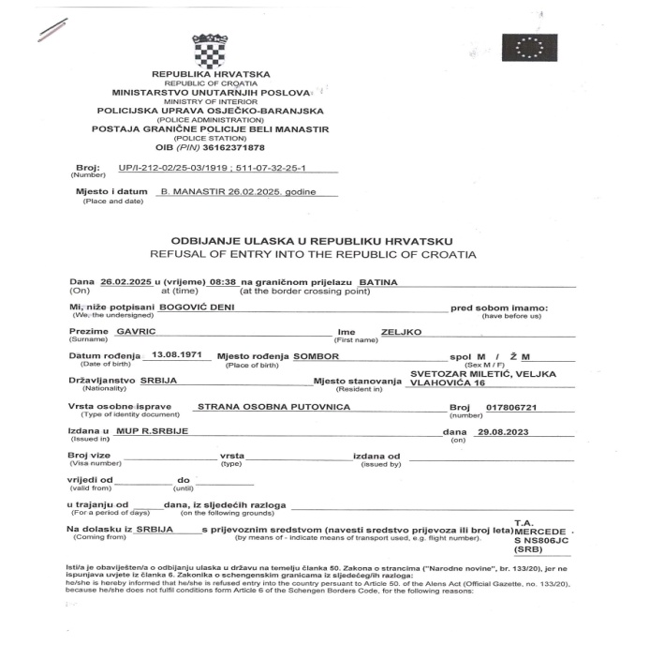
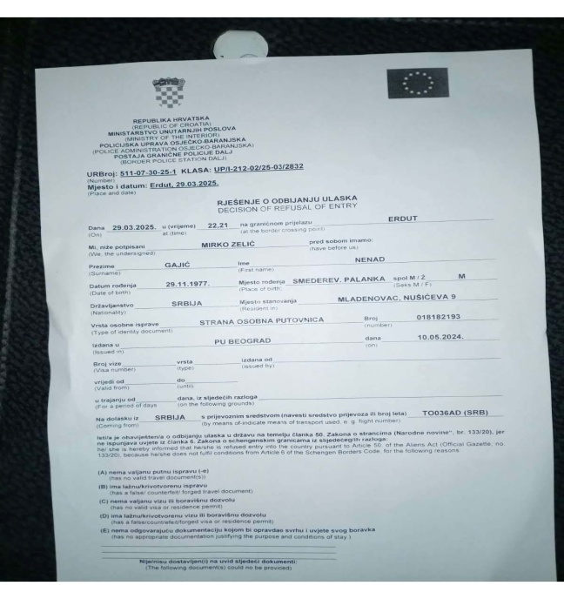
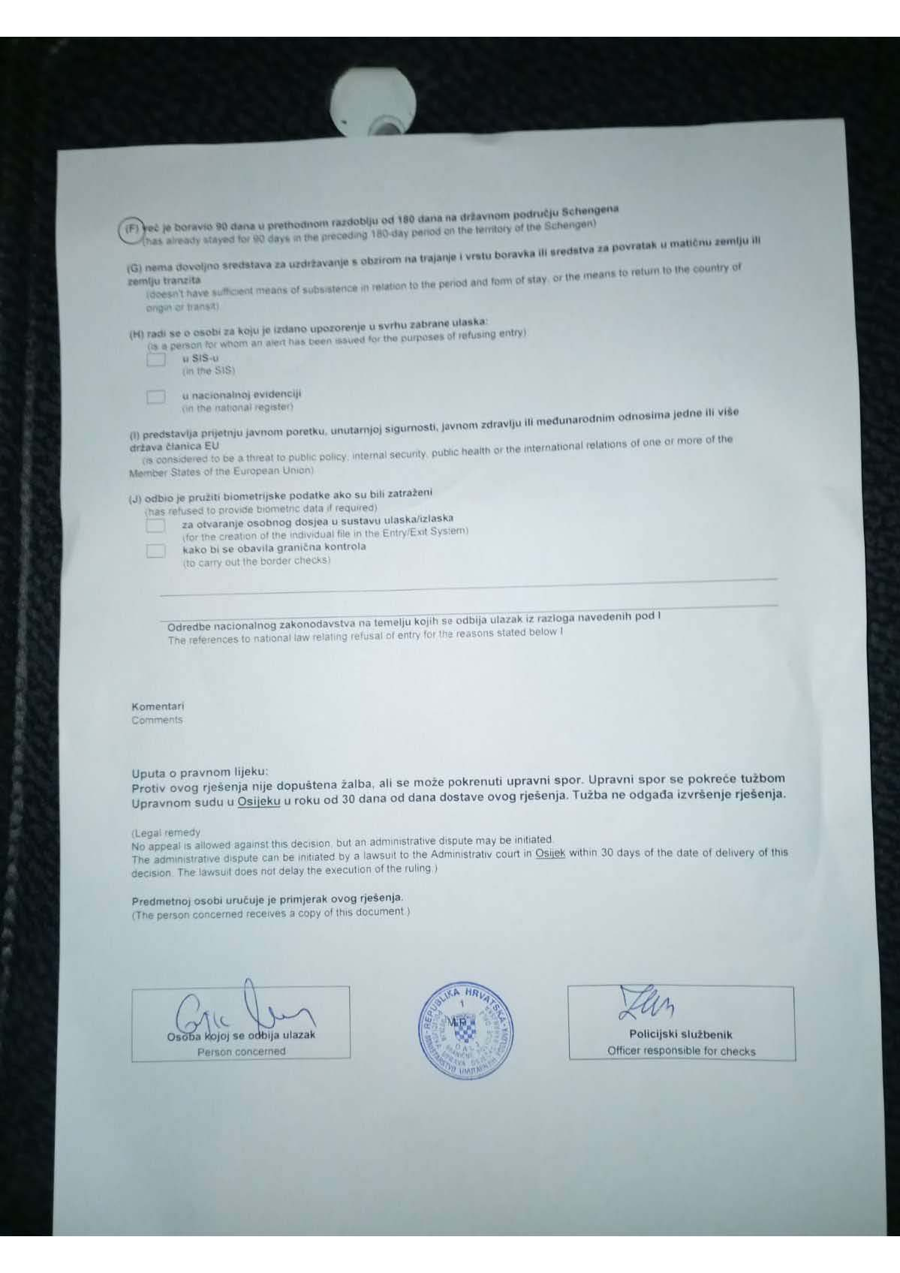

Slide 31
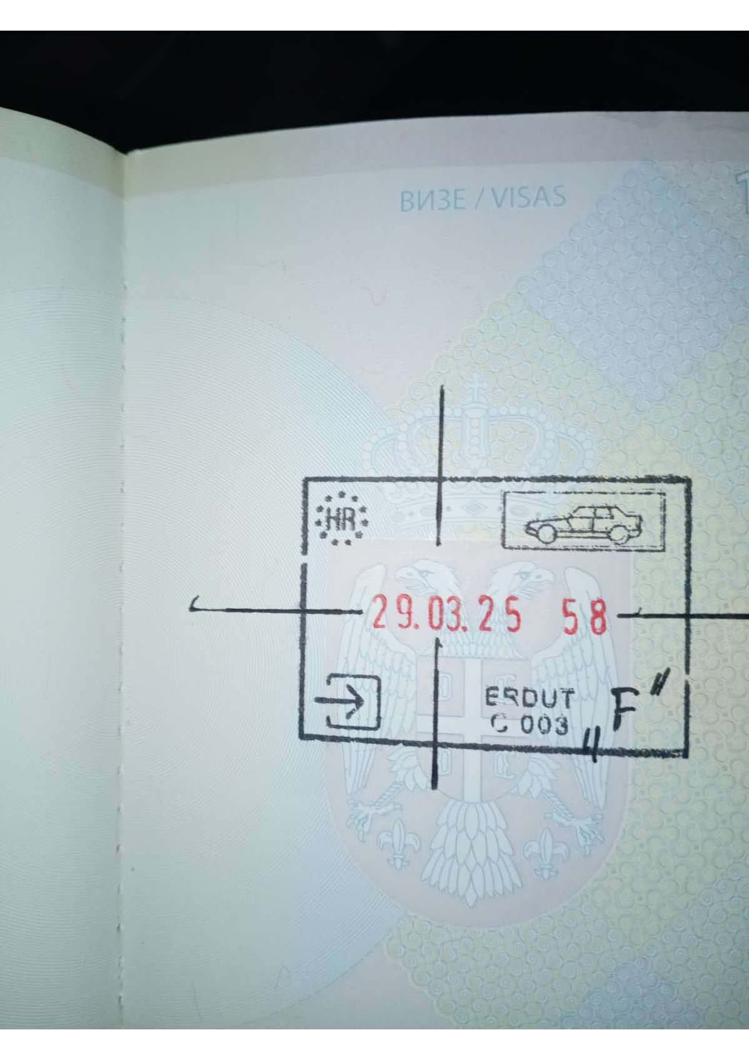
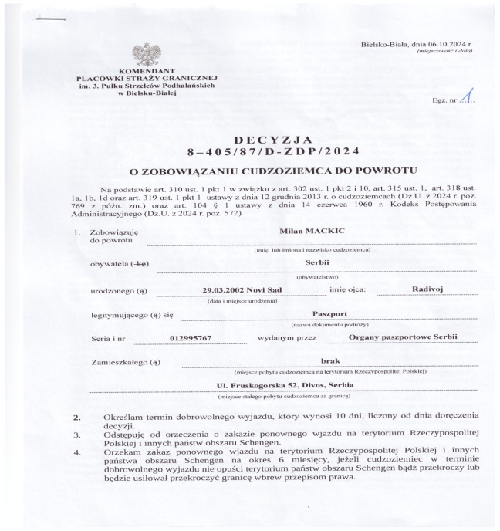
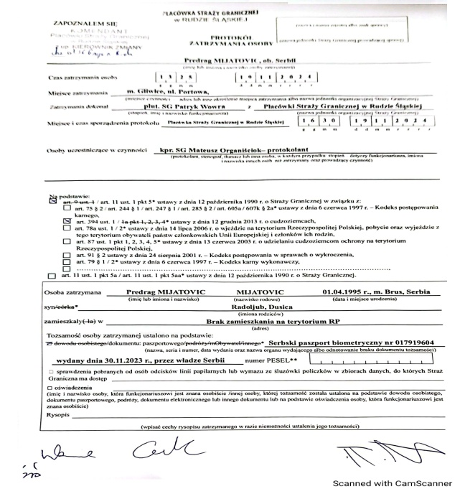
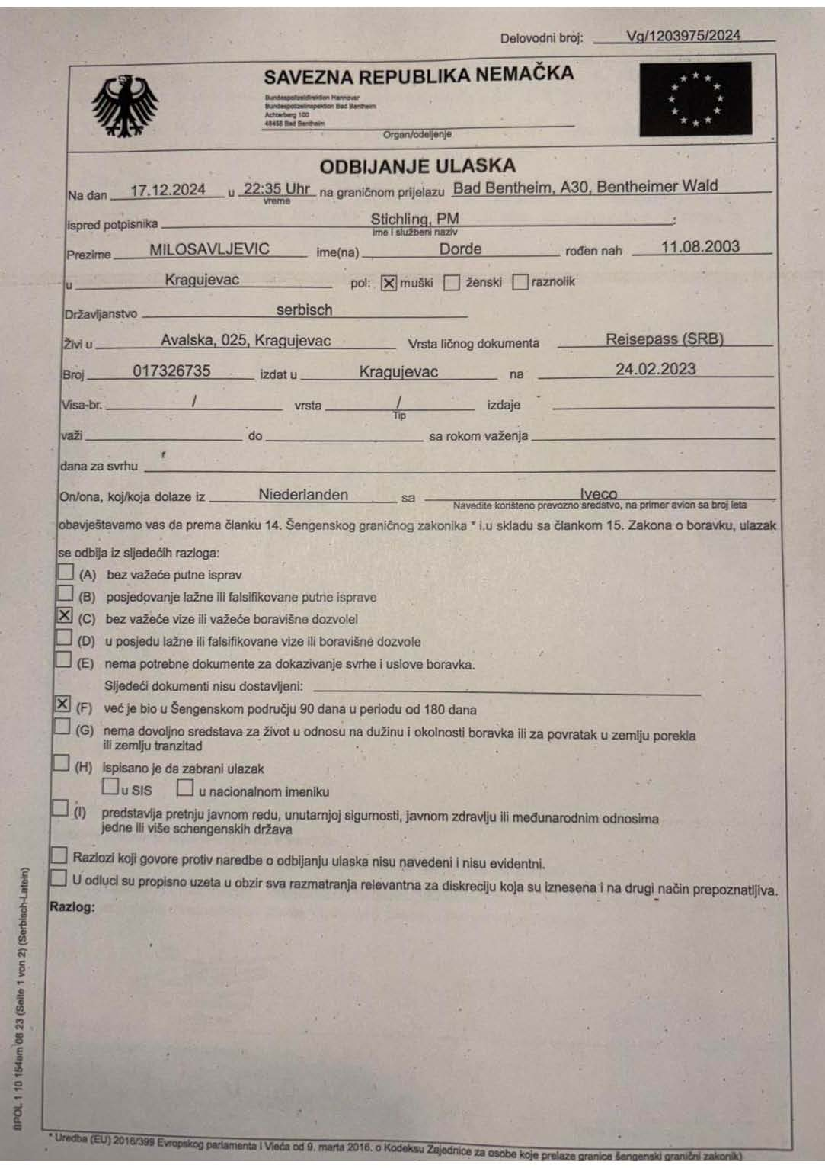

Slide 32
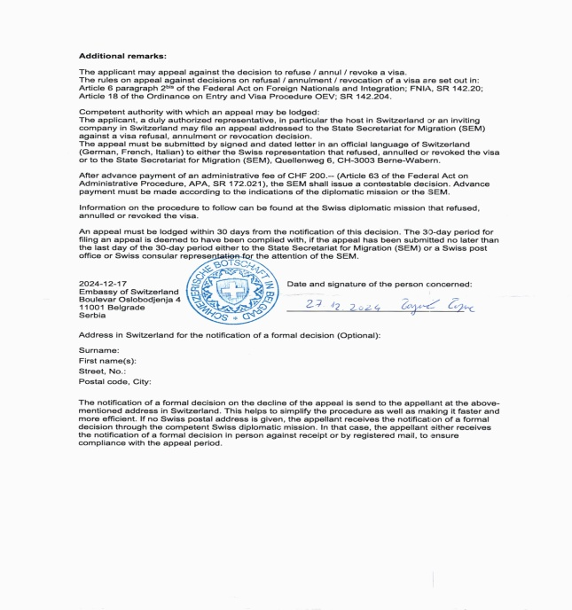
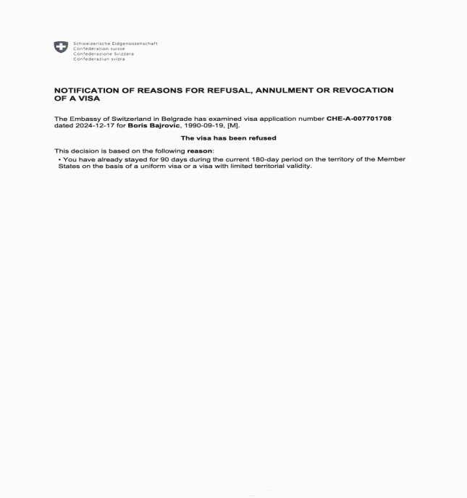
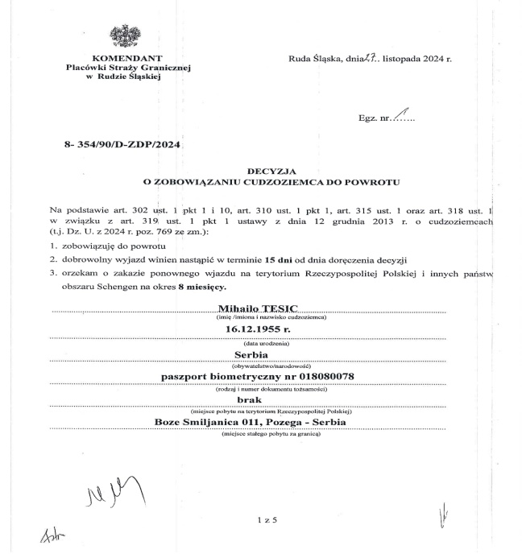
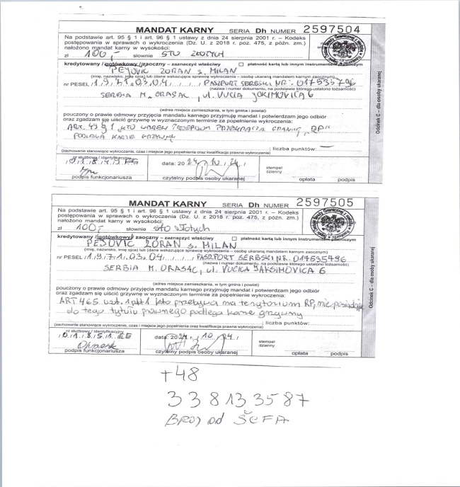
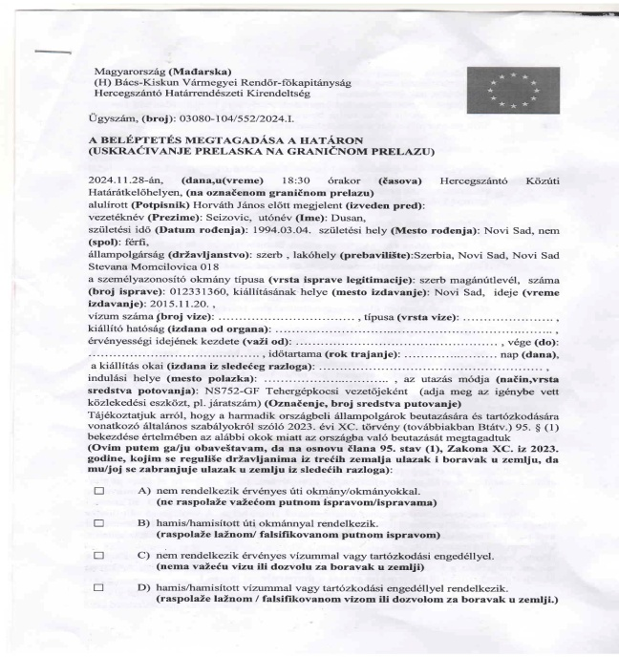

Slide 33
Conclusion
Practically, a professional driver as a cabin crew/crew of a commercial vehicle, transits the Schengen countries on a daily basis in order to reach the final destination which is or is not in the Schengen territory. The sole purpose of every trip is the delivery and dispatch of goods without any delays and also without separation from the place of work - the truck. This is easy to see on the basis of the frequency crossings of the external borders of Schengen.
Professional drivers are not staying. They are driving proffesional and valuable good vehicles through the many countries of the territory of Schengen to bring people of Schengen and people out of Schengen food, medicaments, accessories… and to keep alive industries of European countries.
Let’s help them to keep driving!
We ask here for iniciative for ammendment for exclusion of drivers from the limmited number of days in theritory of Schengen.

Slide 34
Thank you!
Aleksandar Spasic, M.Sc. traffic and transport engineering Secretary General Serbian Association of International Road Hauliers "Medjunarodni transport“ +381 (0)63 318 138 aleksandar.spasic@pumedtrans.com www.pumedtrans.com

